Slide 1
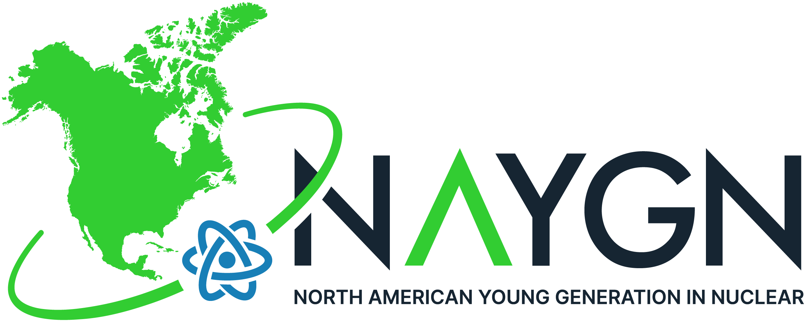
Intro to Nuclear Technology
Presented with support by NAYGN & CNL
Notes:
Intro of CNL, NAYGN
Intro of presenters
Today we will talk about…

Slide 2
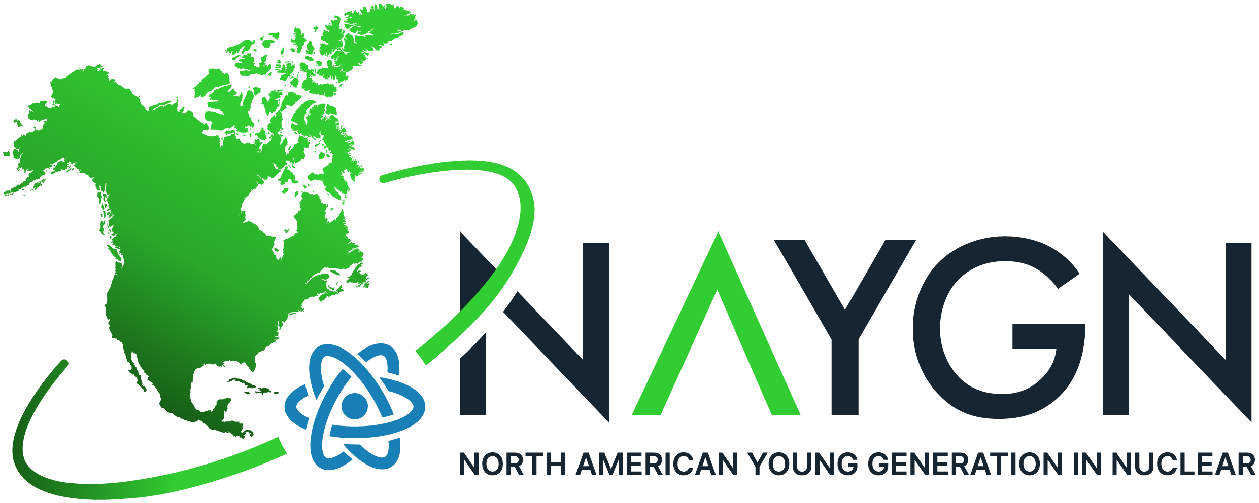
NAYGN
North American Young Generation in Nuclear
Professional Development
Public Information
Knowledge Transfer
Networking
Chalk River Chapter
Hosted 11 events in 8 months since conception
Adopted Petawawa Blvd.
Met with federal & provincial politicians
Supports local charities
Notes:
NAYGN provides opportunities for a young generation of nuclear enthusiasts to develop leadership and professional skills, create life-long connections, engage and inform the public, and inspire today's nuclear technology professionals to meet the challenges of the 21st century.

Slide 3
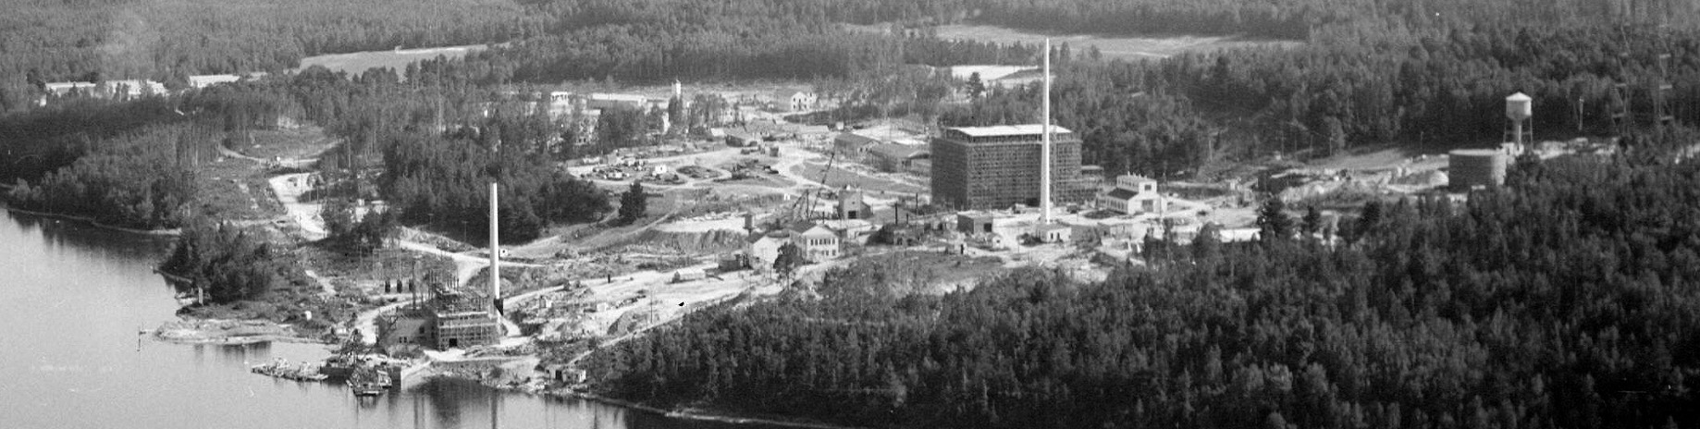

CRL History
Birthplace of Canada’s nuclear industry
First sustained nuclear criticality outside USA
Supplied Cobalt-60 for first cancer treatment in Canada
Developed CANDU power reactor technology
Supported numerous Nobel Prize winning research activities
Notes:
We stand proud as a global leader advancing nuclear science and technology. The world comes to us to solve the toughest technological challenges. We have the most effective industrial partnerships of any national laboratory. Our campuses are home to a vibrant community of the world’s brightest innovators. Our people know they are making a difference in the lives of people around the world. Our customers in industry and the Canadian government value us.

Slide 4
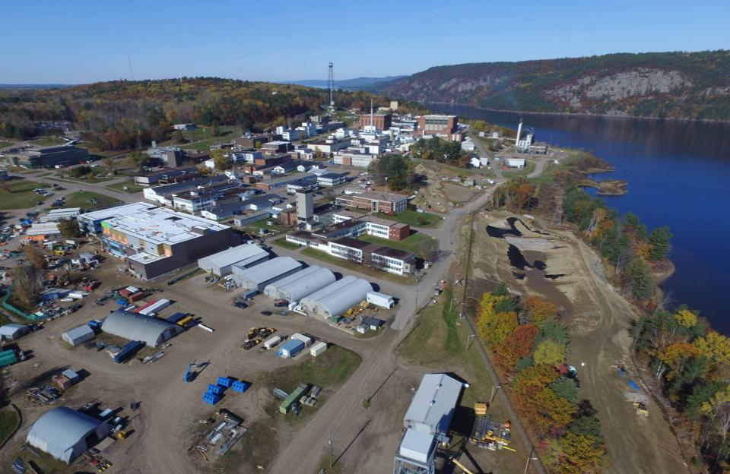
~10,000 acres in size
~200 acre lab complex
17 nuclear facilities
70 major buildings
2,800 employees
~1,600 engineering, scientific, and technical staff
~500 PhDs and Masters
~300 licensed skilled trades
Administrative and Business professionals
Chalk River Laboratories
Notes:
Birthplace of Canada’s nuclear industry
First sustained nuclear criticality outside USA
Supplied Cobalt-60 for first cancer treatment in Canada
AECL established as a Crown Corporation in 1952
Developed CANDU power reactor technology
FYI if there is a question on Indigenous workforce:
From 2015 Employment Equity Stats:
It is self reported there were 224 employees that identified themselves as Aboriginal in 2015, so Indigenous people represented 6.4% of CNL’s total workforce.

Slide 5
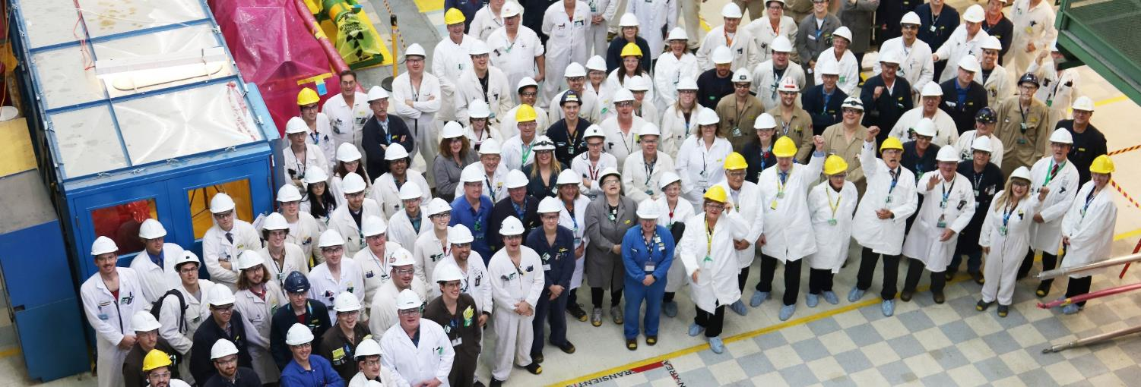

Legacy of Research at Chalk River
Clean energy
More than one billion people benefited from life-saving medical procedures worldwide
Major international facility for physics and health research
Resulted in ground-breaking innovations spanning multiple industries
Supported numerous Nobel Prize winning research activities
Notes:
CORE VALUES
Safety
Respect
Teamwork
Accountability
Integrity
Excellence

Slide 6
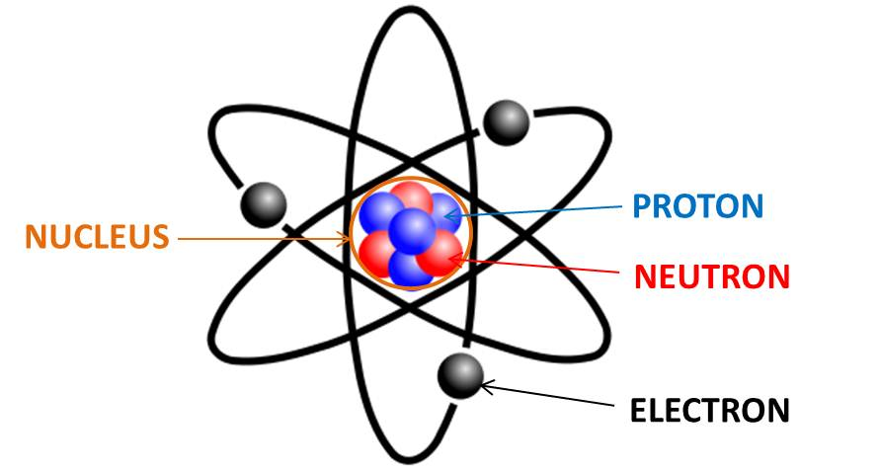
What is Nuclear?
Nuclear relates to a naturally occurring radiant energy that is housed in the nucleus of an atom.
Notes:
We are all made up of atoms. Atoms are made up of three main components – Proton, Neutron, Electron
Q – Do you have any examples of radiant energy?
-Sun, Light, Heat

Slide 7
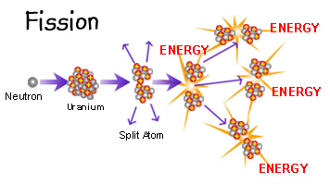
What is Nuclear?
Nuclear Fission
A neutron beam is used to break apart the uranium atom.
When the atom splits and forms two smaller atoms, energy is released in the form of heat.
The heat energy is then captured and utilized to produce electricity.
Notes:
Video: What is Nuclear Fission?
Q – What other ways can we produce electricity?
Q – What is green energy?

Slide 8


What is Nuclear?
It is Everywhere
Notes:
Since a typical banana contains about half a gram of potassium, it will have an activity of roughly 15 Bq.
The sun warms the earth through radiant energy produced by nuclear fusion

Slide 9
What Does Nuclear Do?
Nuclear Fuel Cycle
Uranium ore is mined from the ground
The Uranium is then processed into nuclear fuel
The fuel is then placed in a reactor
The reactor produces heat which is used to make steam
The steam spins a turbine which makes electricity
Source: Cameco Corporation www.cameco.com/uranium_101/
Notes:
Mine-processing (uranium pellet) -fuel-bundle-reactor-waste
Demo – Fuel Bundle

Slide 10
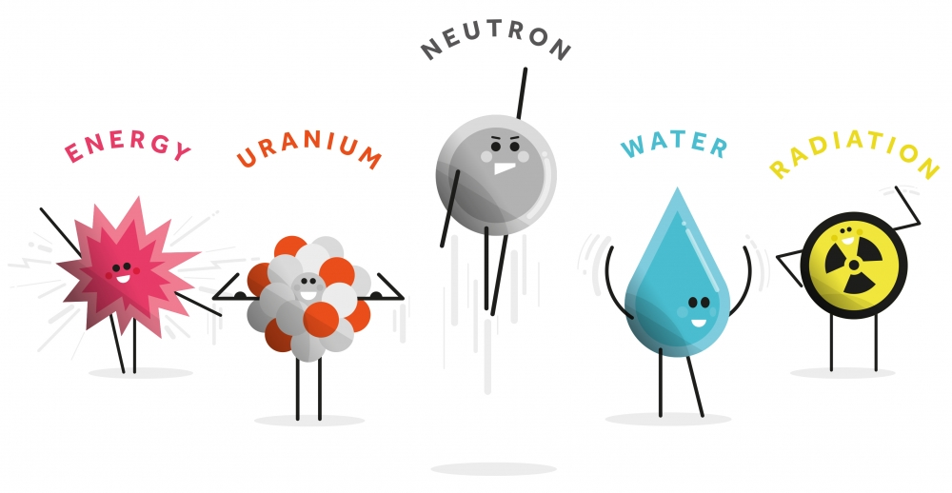
What Does Nuclear Do?
Nuclear Energy
Do you have any examples of energy or energy sources?
Notes:
Video: How Does Nuclear Energy Work?

Slide 11
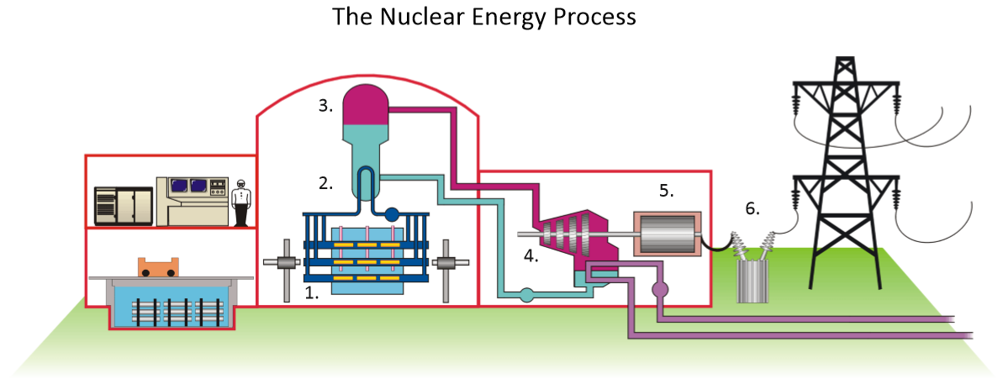
What Does Nuclear Do?
Nuclear Power Plant
Notes:
Video: How Does A Nuclear Power Plant Work?
Fuel-reactor-heat-steam-turbine-electricity
Does not release pollutants into the air
Use heat realeased

Slide 12
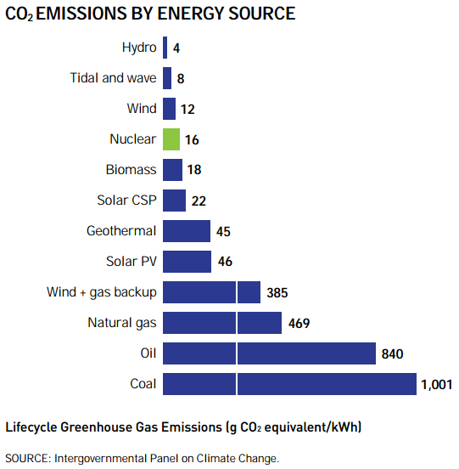
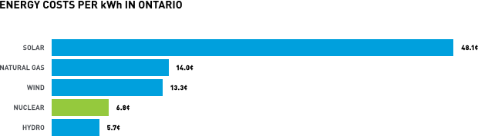
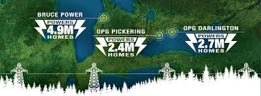
What Does Nuclear Do?
Low Carbon Energy Production
Notes:
Ontario – one of cleanest grids in the world
Nuclear – large initial cost, low per KW/h

Slide 13
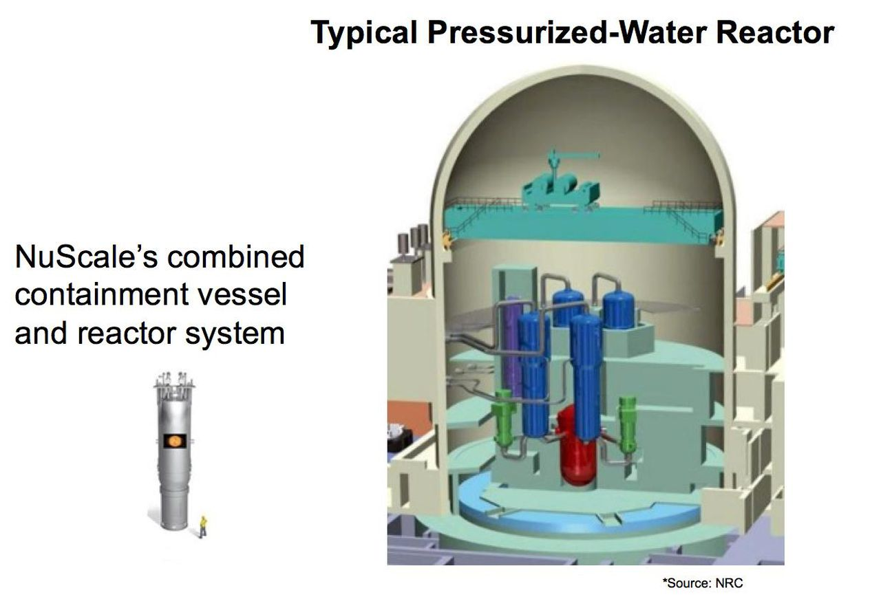
What Does Nuclear Do?
Small Modular Reactors (SMR)
Notes:
SMR’s are an exciting technology that are quickly being adapted from marine applications and theory to practical sources of domestic energy.

Slide 14
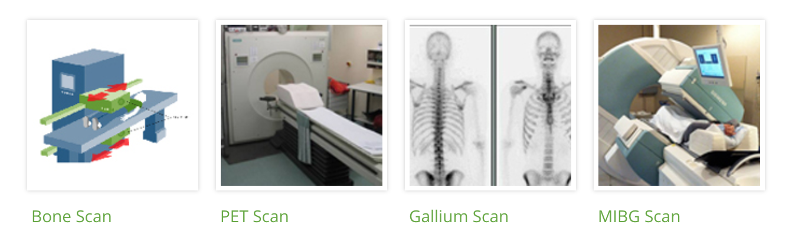
What Does Nuclear Do?
Nuclear Medicine
Nuclear Medicine
Diagnosis:
After diagnosis, Nuclear Radiation Therapy can be used to treat patients.
Marie Curie
Notes:
Video: The Genius of Marie Curie (A video on her life and advances in chemistry and physics)
Facts about Marie:
She discovered Radium and Polonium
1903: First women to be awarded a Nobel prize (Physics)
Was awarded the 1911 Nobel Prize in Chemistry for her discoveries and studies of the elements radium and polonium. She is the only woman so far, who has been awarded the Nobel Prize twice.

Slide 15
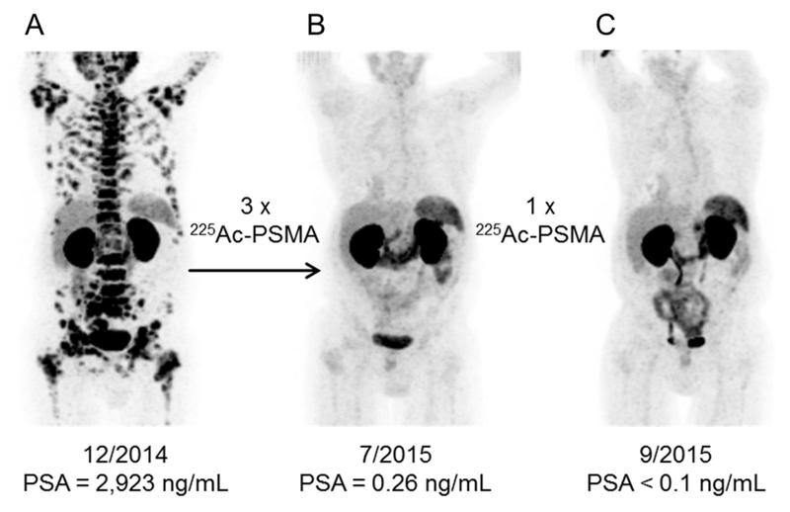
What Does Nuclear Do?
Nuclear Medicine
Actinium 225 Targeted Alpha Therapy:
Notes:
Positive: Ac 225 TAT only “attacks” cancer cells … has shown great results
One Problem: it is so rare that there has not been large scale medical trials done
How CNL is involved: , TRIUMF’s high energy proton beam will be used to manufacture the isotope, while CNL’s nuclear-licensed handling and production facilities will be used to process the material, which is expected to increase global supplies to levels that could permit hundreds of thousands of treatments every year.

Slide 16
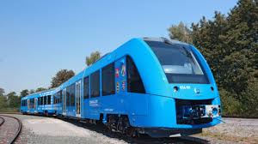

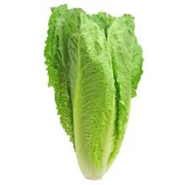

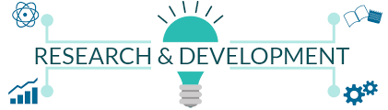
What Does Nuclear Do?
Clean Water, Sterilize Food, Produce Hydrogen
Notes:
Water desalination – awesome where salt water is abundant, fresh water is rare
Jobs – stable, high paying
Food Sterilization – good for long travels … ex rations to poorer countries
Research & Development – Partnered with auto, space, aero, medical etc

Slide 17
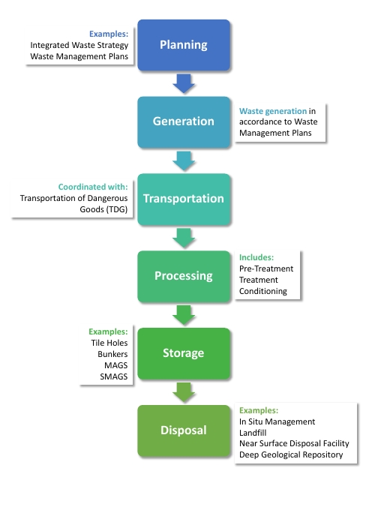
Nuclear Waste Management
Waste Management Lifecycle @ CNL
Notes:
-

Slide 18
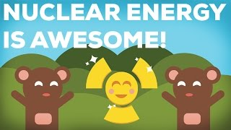
Why We Should Chose Nuclear!
What is something you learned about nuclear today?
Notes:
Summary Video
Q – what did you learn about nuclear today

Slide 19
Strategic Science &Technology Initiatives
vSMR / Advanced Reactors
Alpha Therapies
Hydrogen
Advanced Fuels
Life Extension
Nuclear Forensics
Cyber Security
What is Next?
Notes:
CNL’s current focus

Slide 20

Thank You!
Notes:
Q’s

