Slide 1





Nuclear Energy
THE ROLE IT HAS IN OUR FIGHT AGAINST CLIMATE CHANGE

Slide 2


What is nuclear energy?
Radioactive elephant in the room
How can nuclear slow climate change?

Slide 3
What is Nuclear Energy?

Slide 4
History of Nuclear
First commercial reactor to generate electricity
Fission reaction
controlled
Atoms for Peace Speech
1945
1955
1942
First atomic bomb goes off
1953
Nuclear-powered
vessels
1957

Slide 5

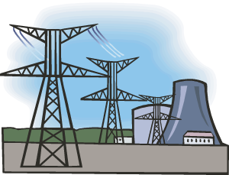
Bombs
Any reactor that produces electricity for the grid, does NOT produce weapons-grade material.
Makes producing bombs significantly harder and more expensive.

Slide 6
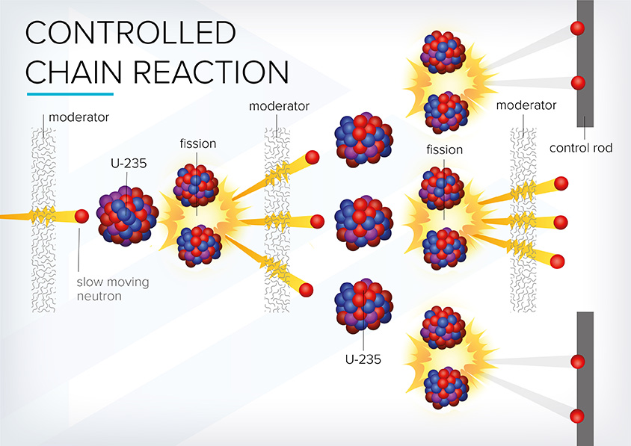
Fission

Slide 7
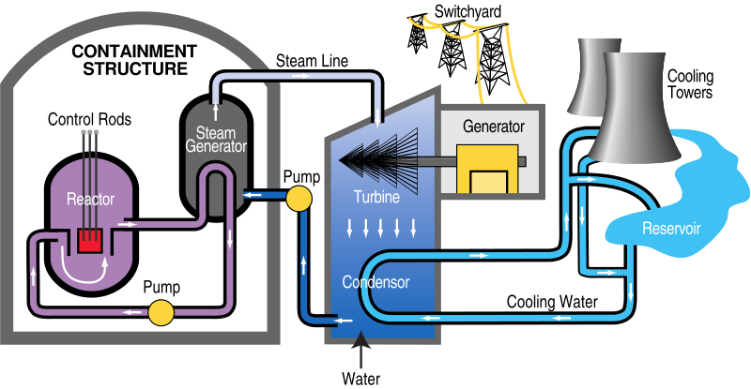
Turning on the Lights

Slide 8
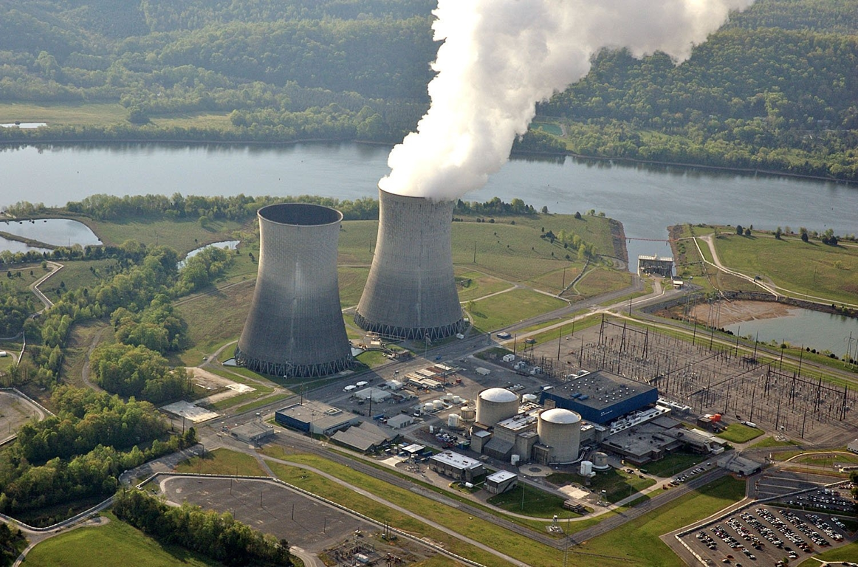

Slide 9
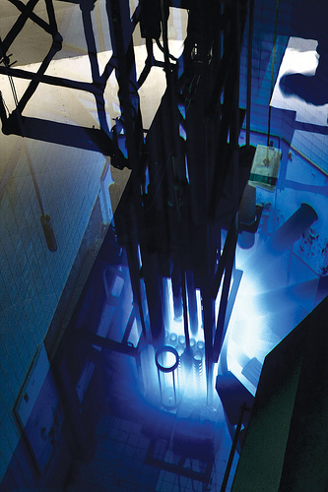

Slide 10
Radioactive Elephant in the Room
Accidents & Waste

Slide 11

Chernobyl – Health Effects
No containment building – reactor on fire raining radiation
28 deaths from acute radiation syndrome
15 deaths of thyroid cancer over 25 years
16,000 thyroid cancers predicted – 1% death rate
No (scientific) increase in thyroid cancer outside 3 republics
No effect on fertility, malformations, or infant mortality
No conclusion on adverse pregnancy outcomes or still births
Heritable effects not seen
No proven increase in any other cancer
  Including liquidator cohorts
https://www.unscear.org/unscear/en/areas-of-work/chernobyl.html#:~:text=Health%20effects,and%20suffered%20from%20radiation%20sickness.

Slide 12
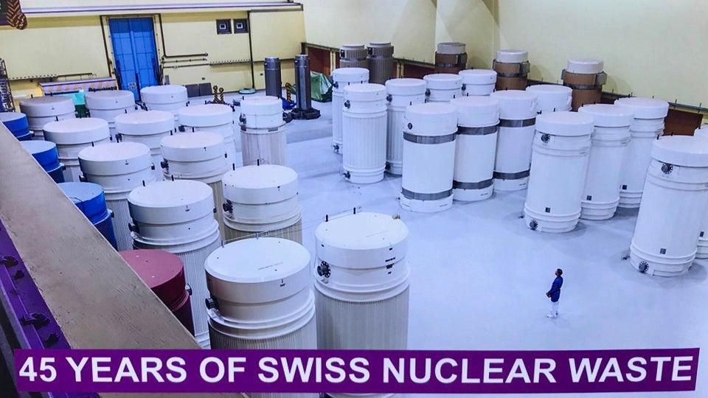
Nuclear Waste
The spent uranium is highly radioactive and has to be kept and stored safely – easy to store as it is solid!
Only energy source that the waste is kept track of and has never harmed anyone

Slide 13
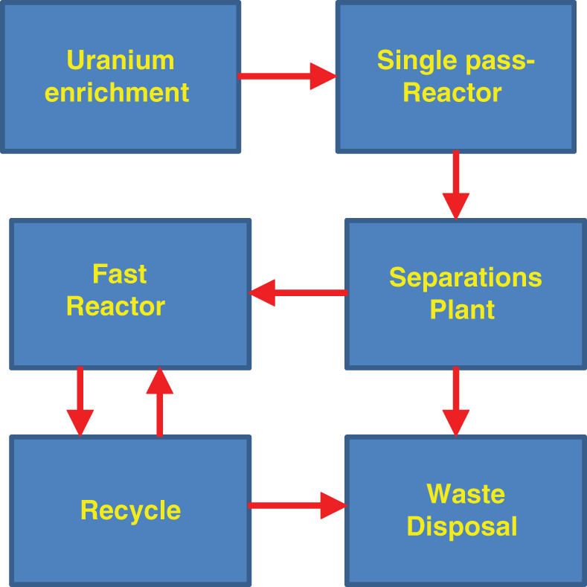
Nuclear “Waste” – upcycling

Slide 14
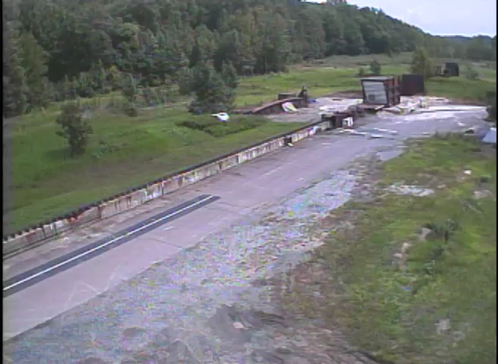
Storage

Slide 15
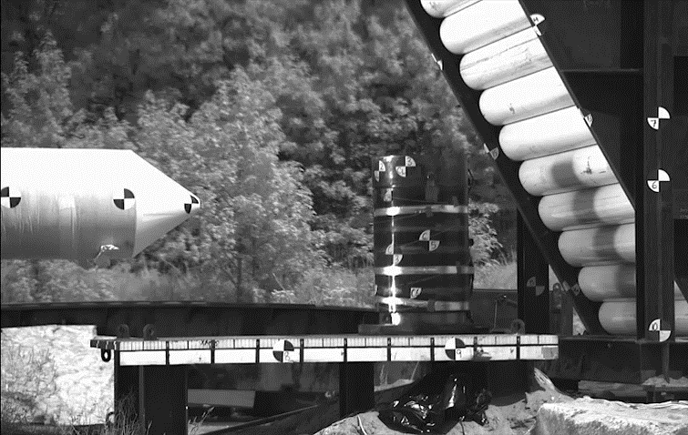
Storage

Slide 16
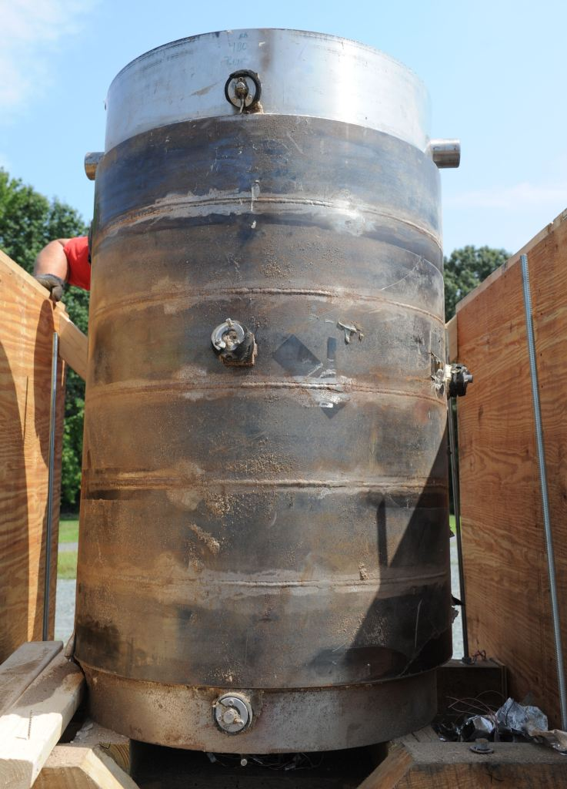
Storage

Slide 17
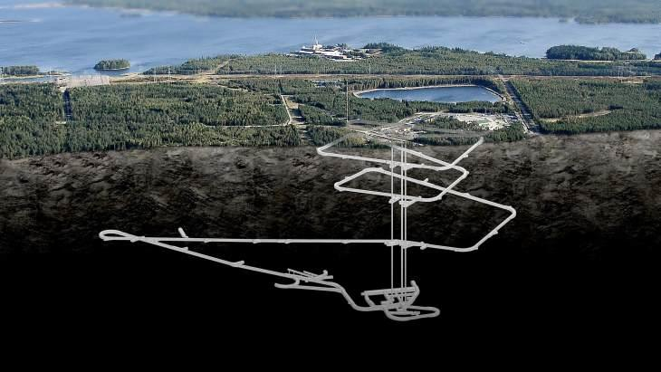
Storage
Waste currently stored at the plants
Onkalo
  First permanent underground storage facility
  Set to open in 2024 in Finland
  Hold 100 years' worth of waste
  Extremely safe
  Surrounding area embraces it and has 100% trust in their government

Slide 18
Question:
  How much spent nuclear fuel has Canada EVER produced?
  (in terms of a hockey rink, 1 telephone pole high)

Slide 19
Nuclear – Net Zero Hero

Slide 20
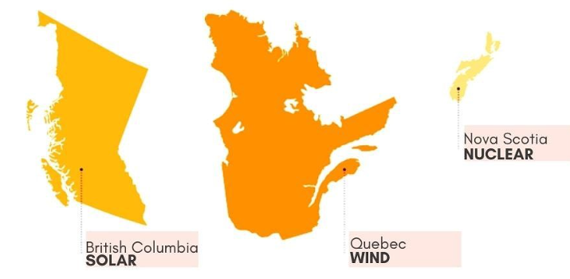
Energy Dense
→land conservation
Here’s how much land it will take to produce 100% global electricity from one energy source

Slide 21
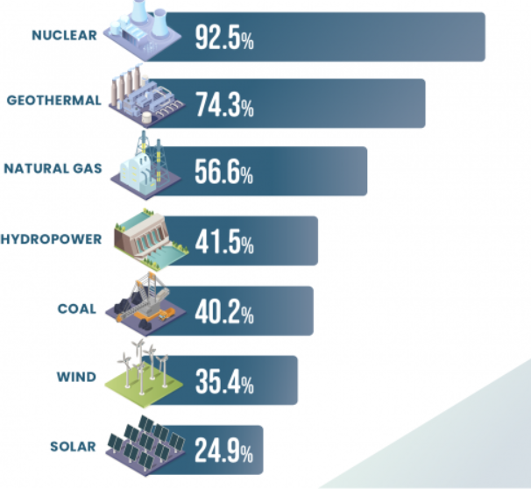
The Sustainable Powerhouse
Capacity factor of 92% → most reliable energy source
Lasts for 60+ years → lasting decarbonization for investment
Energy Security
Provides life-saving medical
isotopes
Low overall system costs for
the consumer
Offers the highest paying,
highest skilled jobs at bulk
Increases GDP of area
Just transition from coal/gas
regarding job retention

Slide 22
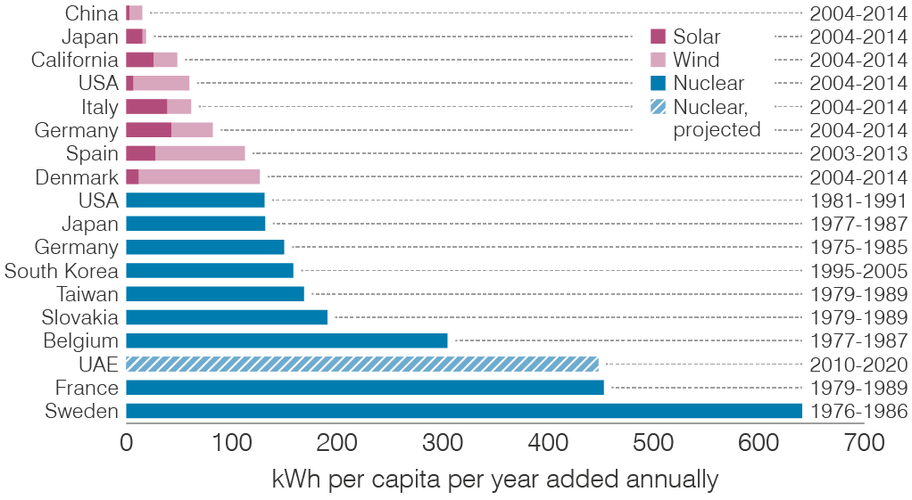
Fastest Way to Decarbonize
Build-times of low carbon electricity

Slide 23
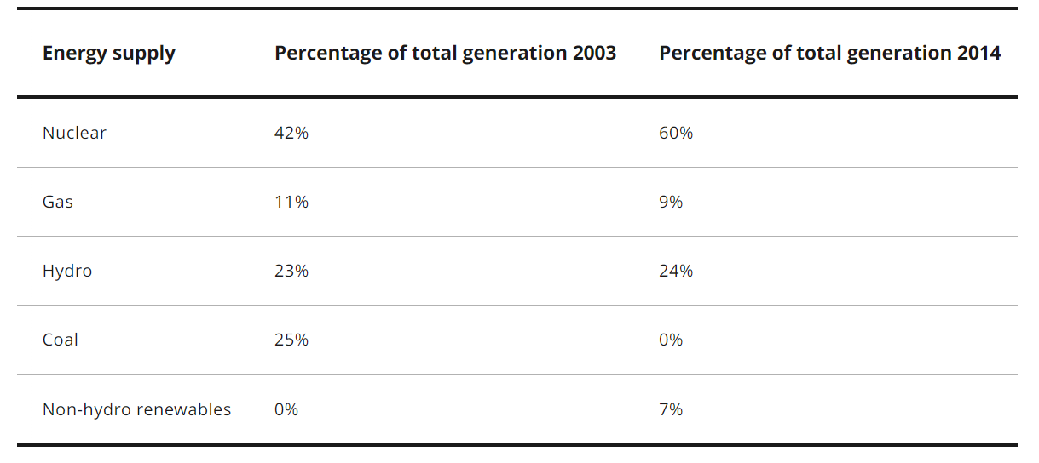
Ontario’s Coal Phase-Out
The elimination of coal stands as the single largest greenhouse gas (GHG) emissions reduction action on the continent.
Nuclear: +1,500MW
Gas: + 5,500MW
Non-Hydro Ren.: + 5,500MW
Coal: -7,500MW

Slide 24
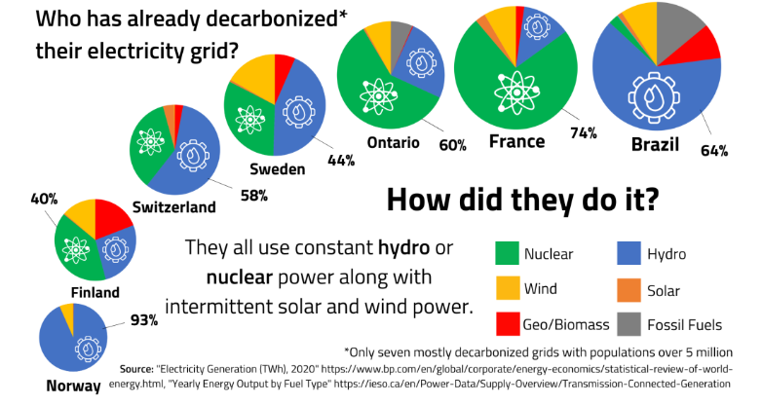
Decarbonizing the World
Notice how Germany is not on here
Lots of countries look like Norway

Slide 25

Future of Nuclear
“If current trends continue, compliance with climate objectives will require a six-fold increase in global nuclear capabilities.“
“The use of nuclear power increases
in all four pathways in relation to 2010,
by between 59 and 106% by 2030 and
by between 98 and 501% by 2050”
https://www.orano.group/en/unpacking-nuclear/all-about-the-ipcc-report-on-climate-change#:~:text=All%20the%20IPCC%20scenarios%20require%20more%20nuclear%20power&text=The%20use%20of%20nuclear%20power,%2B501%25)%20by%202050.

Slide 26
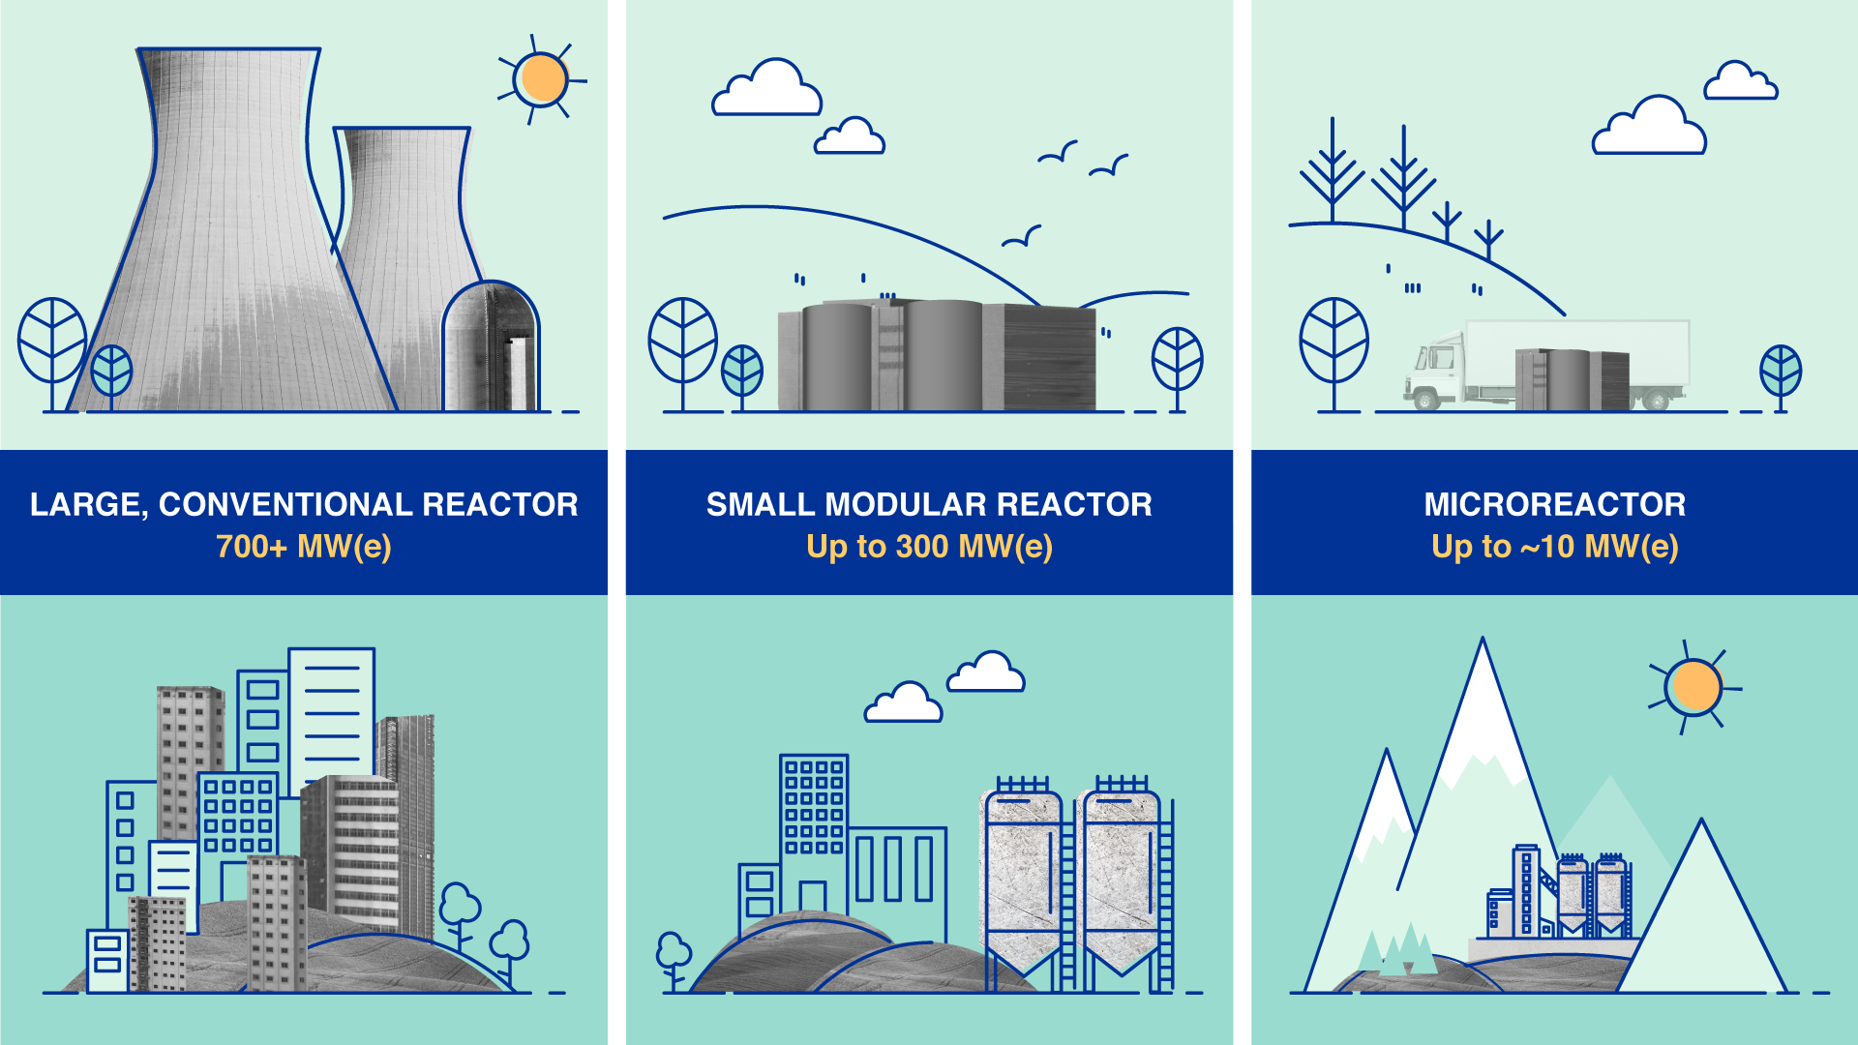
Full Steam Ahead!

Slide 27
Thank You!

Slide 28
References
https://www.energy.gov/ne/articles/10-intriguing-facts-about-worlds-first-nuclear-chain-reaction#:~:text=On%20December%202%2C%201942%2C%20the,a%20Nobel%20Prize%2Dwinning%20scientist. [4]
https://www.energy.gov/lm/doe-history/manhattan-project-background-information-and-preservation-work/manhattan-project-1 [4]
https://www.eisenhowerlibrary.gov/research/online-documents/atoms-peace#:~:text=The%20Atoms%20for%20Peace%20speech,Eisenhower%20to%20the%20United%20Nations. [4]
https://world-nuclear.org/information-library/non-power-nuclear-applications/transport/nuclear-powered-ships.aspx#:~:text=The%20first%20nuclear%2Dpowered%20submarine,submerged%20for%20weeks%20on%20end. [4]
https://www.energy.gov/sites/prod/files/The%20History%20of%20Nuclear%20Energy_0.pdf [4]
http://www.ccnr.org/plute.html [5]
https://www.paks2.hu/web/paks-2-en/nuclear-energy-in-plain-language [6]
https://www.energy.gov/ne/articles/nuclear-101-how-does-nuclear-reactor-work [7]
https://world-nuclear.org/nuclear-essentials/what-is-nuclear-waste-and-what-do-we-do-with-it.aspx [12]
https://cdn.ans.org/cafe/2013/09/HH28_17.pdf?_ga=2.81634327.1622797400.1656556366-503591661.1656556366 [14]

Slide 29
References
https://www.science.org/content/article/finland-built-tomb-store-nuclear-waste-can-it-survive-100000-years [17]
https://cna.ca/wp-content/uploads/2022/02/The-Canadian-Nuclear-Factbook-2021-EN.pdf [20]
https://www.energy.gov/ne/articles/nuclear-power-most-reliable-energy-source-and-its-not-even-close [21]
https://world-nuclear.org/information-library/economic-aspects/economics-of-nuclear-power.aspx [21]
http://large.stanford.edu/courses/2018/ph241/may2/docs/nei-apr12.pdf [21]
https://www.world-nuclear.org/getmedia/1962b22f-3e9d-42d1-951a-e4e62f446180/Harmony-Programme-Presentation-March-2018.pdf.aspx [22]
https://www.ontario.ca/page/end-coal [23]
https://www.nerc.com/gov/bot/botquarterlyitems/Coal%20Closure%20in%20Ontario%20-%20v6%20clean-6-2.pdf [23]
https://www.iaea.org/newscenter/news/towards-a-just-energy-transition-nuclear-power-boasts-best-paid-jobs-in-clean-energy-sector [24]

