Slide 1
Master slide

Slide 2
Master slide
NuClear: NEW Nuclear for Clear Air Energy
Introduce Yourself Here Name, Company

Slide 3
What is climate change?
Weather
VS
Climate
Notes:
Weather = day to day
Climate = long term

Slide 4
MOVIE TIME!
https://youtu.be/TDcpvybA-M0

Slide 5
Why is climate change bad?
Notes:
What if the world changed drastically? Many animals might become extinct!
Sad polar bear.
Sad penguin.

Slide 6
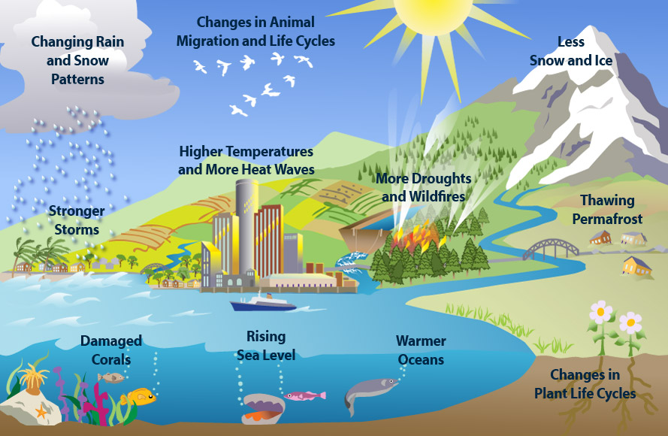
Environmental Protection Agency
Notes:
Here are some other reasons climate change would be very bad.

Slide 7
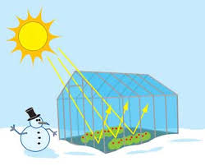
What causes climate change?
Greenhouse Effect
Carbon Dioxide
climatekids.nasa.gov

Slide 8
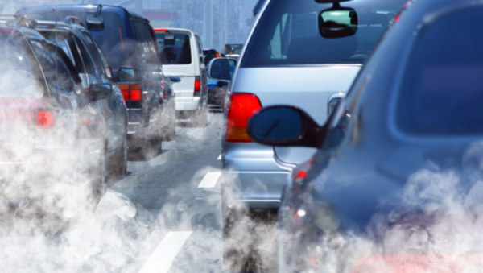
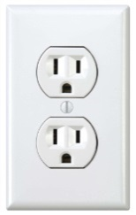
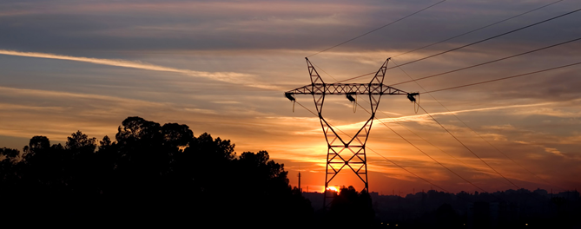
Where does carbon come from?
Cars
Making electricity
Notes:
Energy production from: Fossil Fuels, diesel generators and buring coal
Industry pollution from factories: such as Petrolium refineries, and steel factories.

Slide 9
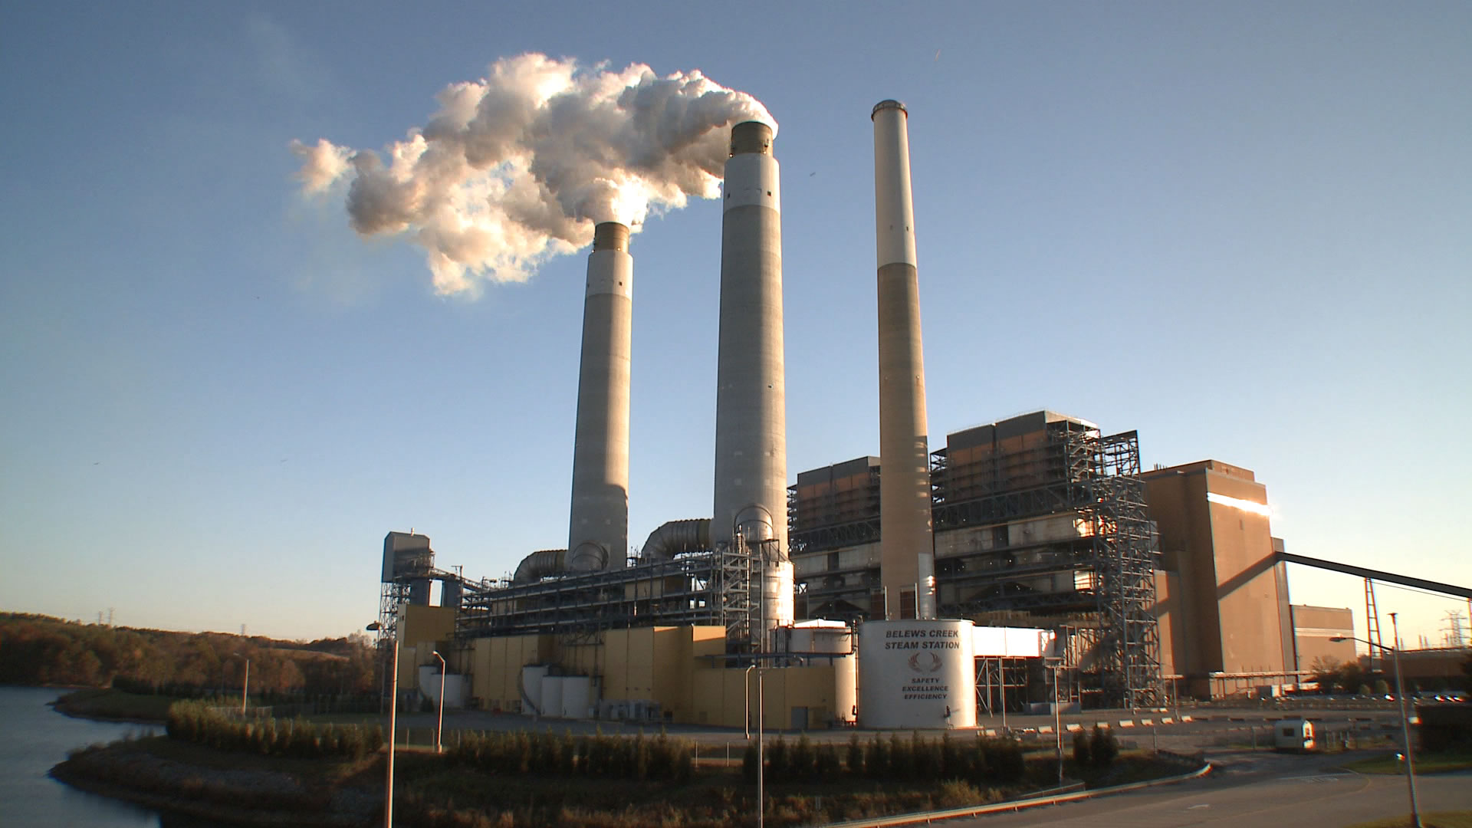
Coal Plant
Carbon dioxide

Slide 10
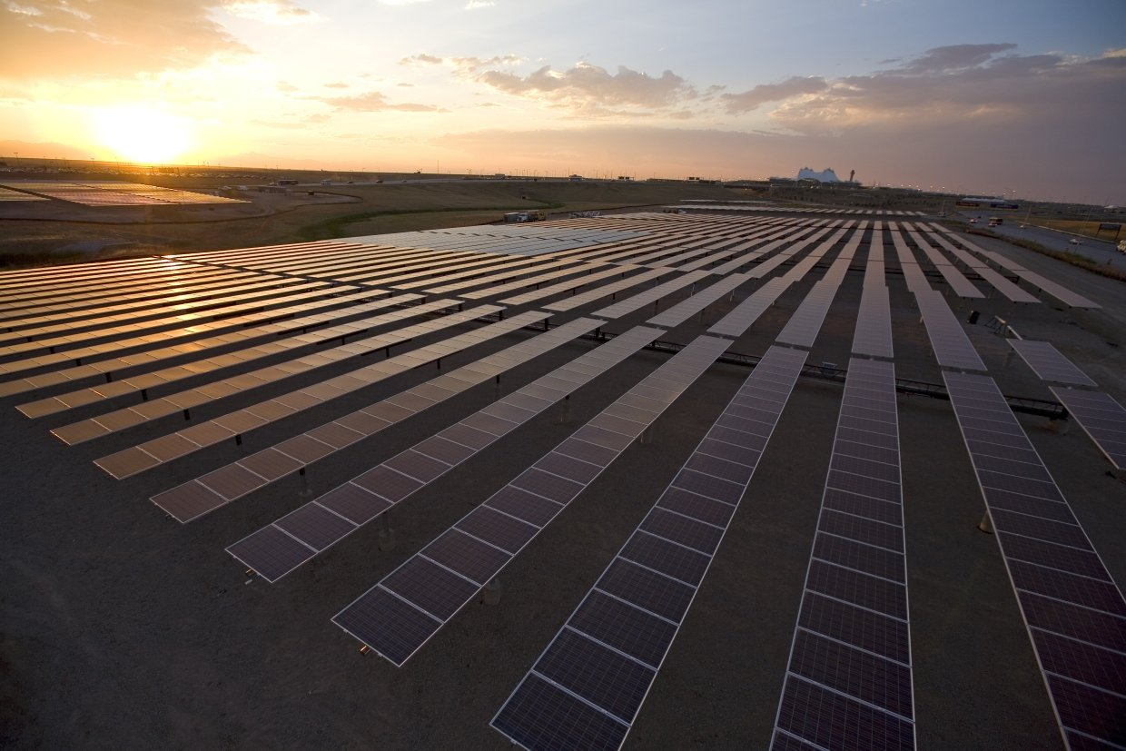
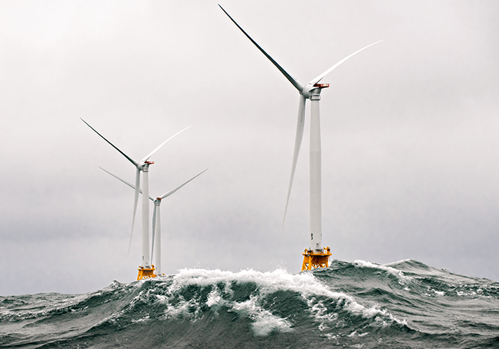
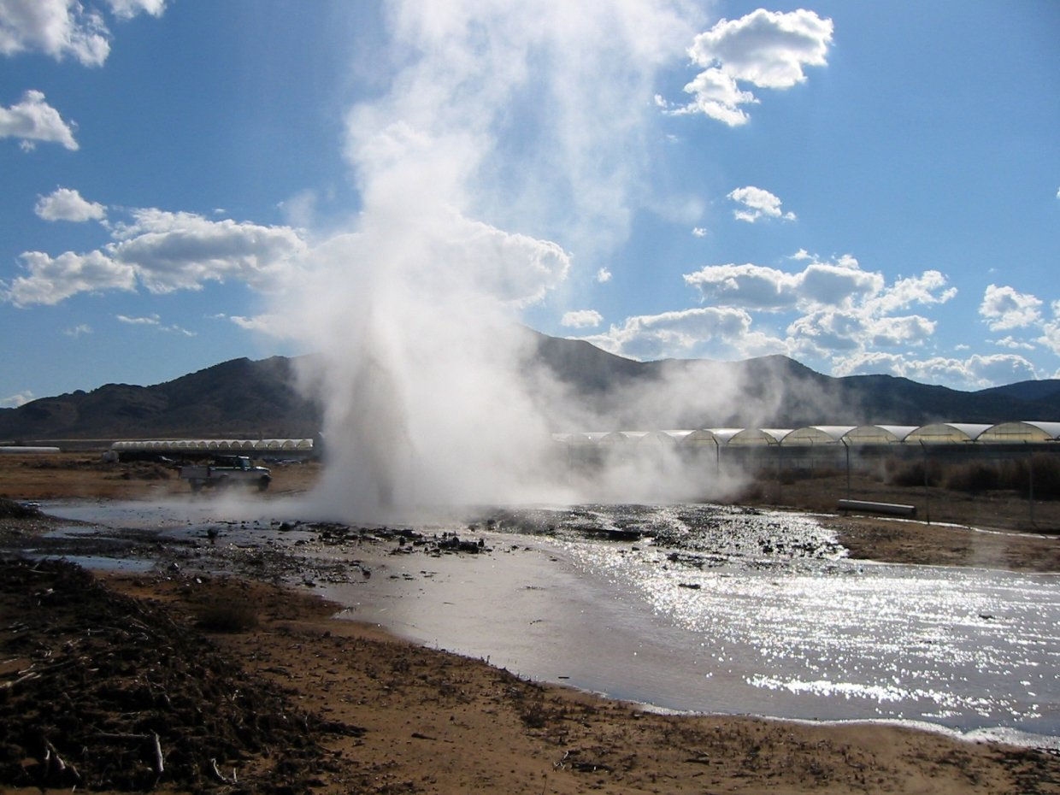
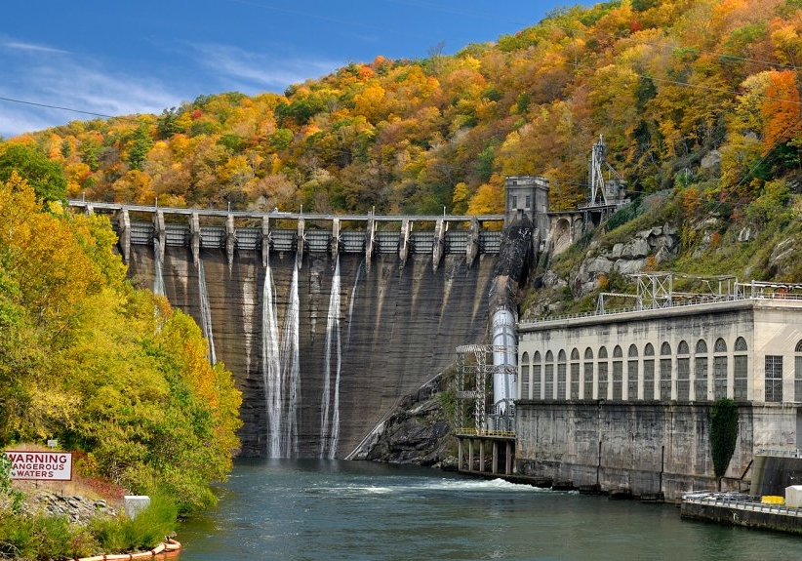
Carbon Free - Green Energy
Solar
Wind
There are CLEAN ways to make electricity
Geothermal
Hydro

Slide 11
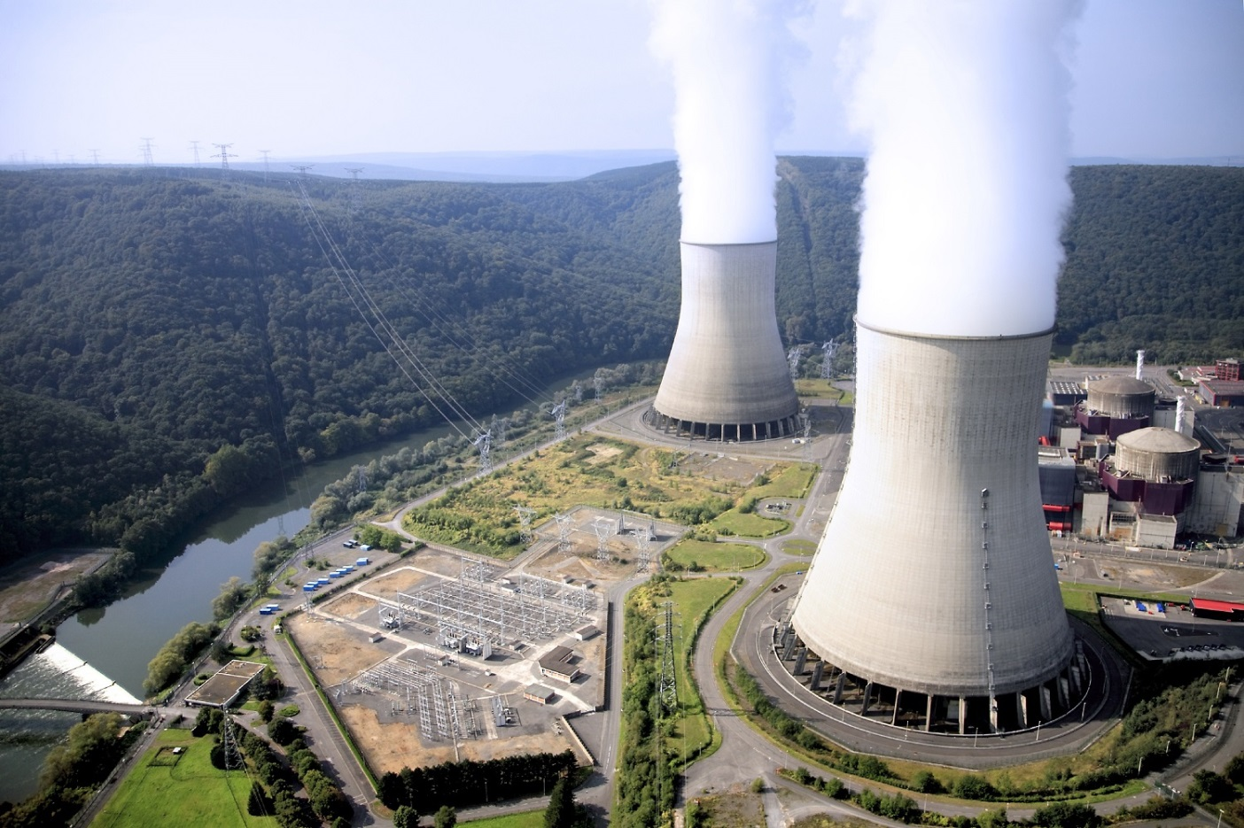
Nuclear?
YES!
carbon
STEAM
Notes:
Really? Nuclear?
Yes!
The cloud coming out of a nuclear plant is not like the cloud coming out of a coal plant.
The cloud out of a nuclear plant is just steam – it’s just water! Nuclear is a carbon free source of electricity.

Slide 12
Decarbonizing the World!

Slide 13
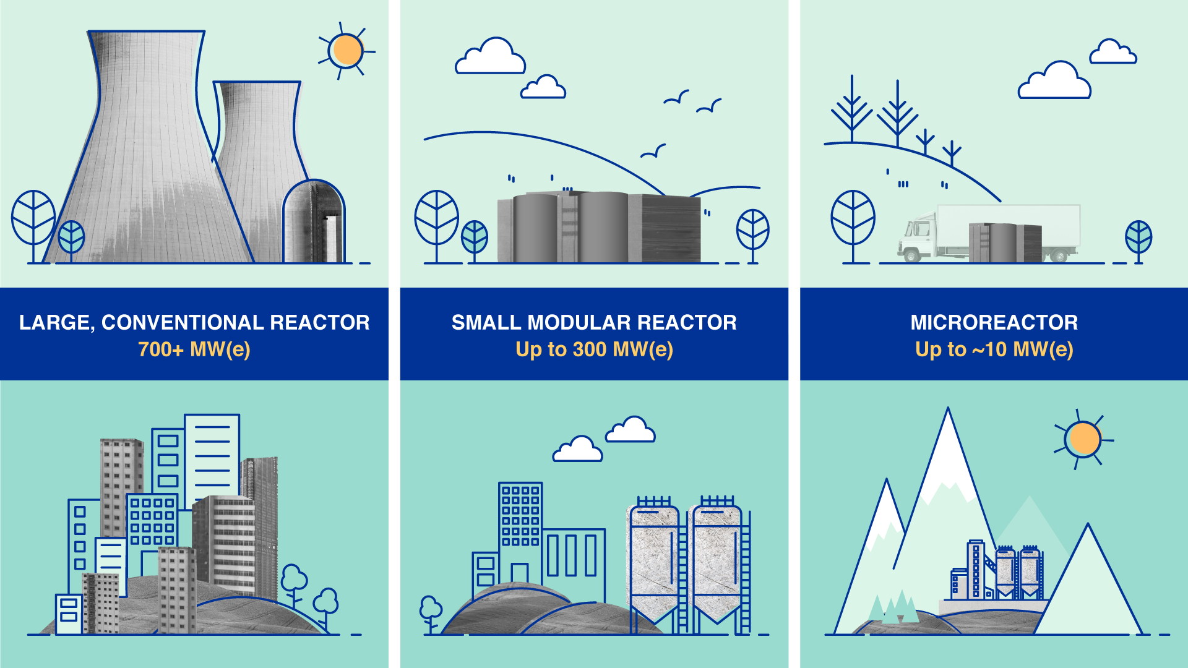
New Nuclear!

Slide 14
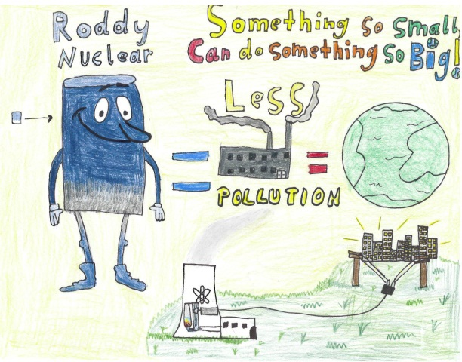
Master slide
2025 Drawing Contest
NuClear: NEW Nuclear for Clear Air Energy
Requirements;
8 ½ x 11” sheet of paper
On the BACK of the drawing write:
Short description of drawing
Student Name
Grade
School and Teacher’s Name
Drawings due February 28, 2025. Emailed to schooloutreach@naygn.org
winners will be announced on March 31, 2025

Slide 15
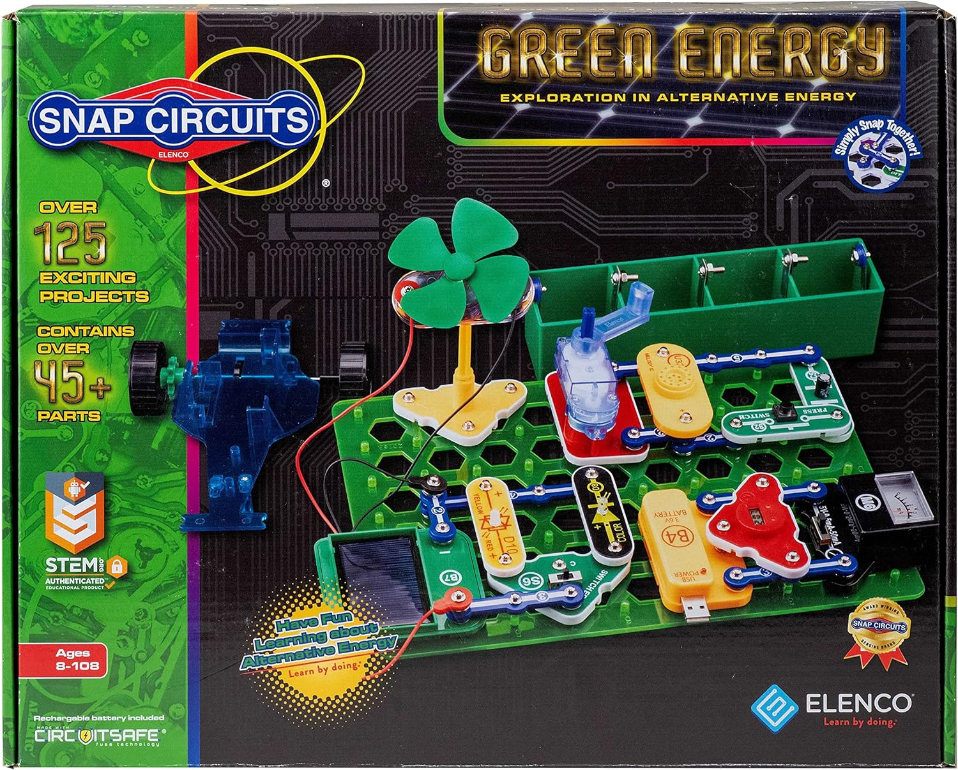
Prizes
Master slide
A Drawing Contest Awards Panel will select 5 students as winners to receive a STEM kit of their choosing from the options below. Winners will be selected based on creativity, style, along with diversity in age and region. Winners will be limited to one student per class.
Doctor Jupiter: My First Science Kit
Butterfly Edufields: Motor Machines
Snap Circuits: Green Energy

Slide 16
THANKS!
Do you have any questions?
Info@NAYGN.org
CREDITS: This presentation template was created by Slidesgo, including icons by Flaticon, infographics & images by Freepik
Please keep this slide for attribution

