Slide 1
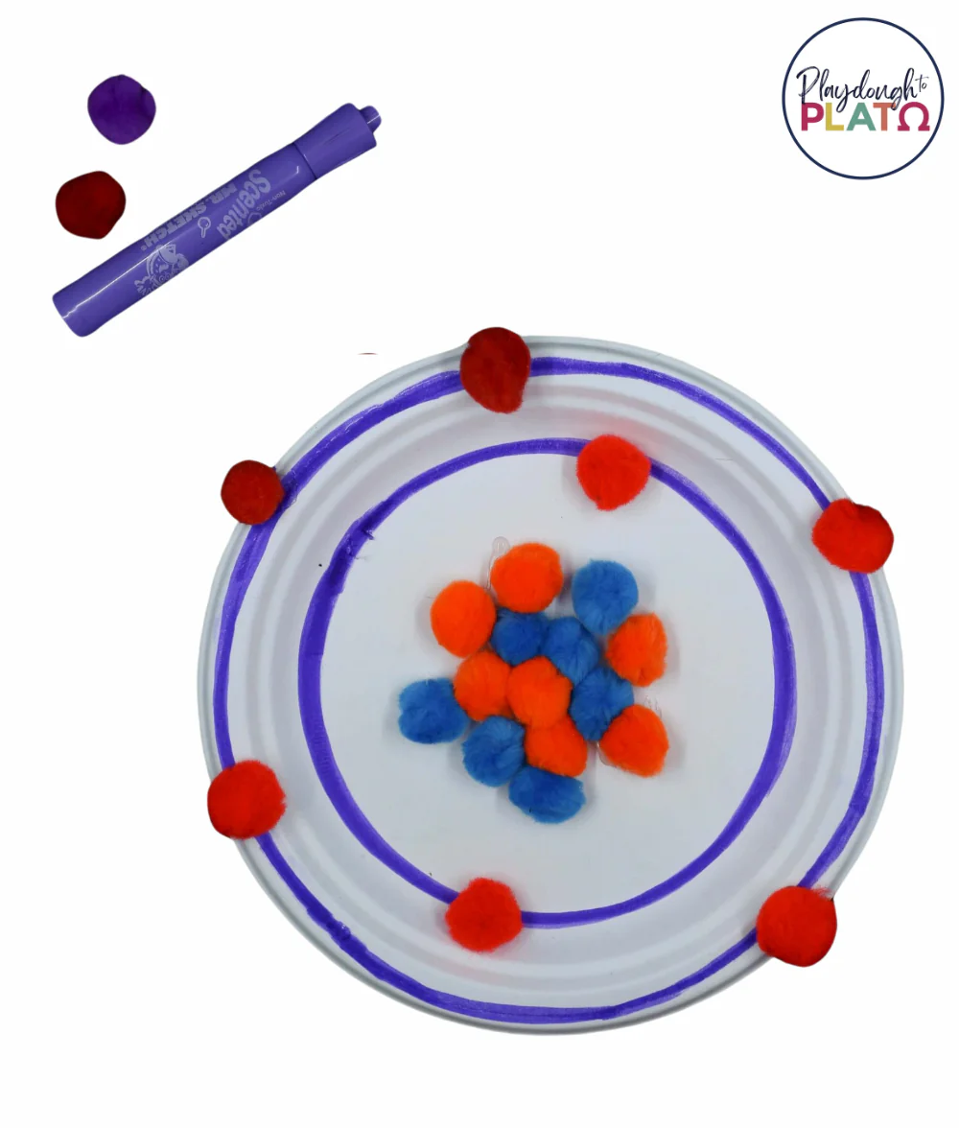
KINDERGARTEN–GRADE 1
Build a colorful atom
15–20 MIN
UNDER $10 / CLASS
CRAFT + DISCUSSION
MATERIALS
Paper Plates
Large red, blue and yellow craft pom-poms
Pipe Cleaners and Glue
Optional: Markers
MAKE THE ACTIVITY
1. Before the visit, pre-cut three orbit strips and prepare one sample atom.
2. Students glue red protons and blue neutrons together to form the nucleus.
3. Wrap and glue the paper strips around the nucleus, then add yellow electrons.
4. Invite students to point to each part and share where atoms can be found.
KEY MESSAGE Atoms have a nucleus made of protons and neutrons, with electrons around it. The craft is a simplified model and is not to scale.
Facilitator tip: Use stickers instead of glue for a lower-mess or accessibility-friendly option.
NAYGN STUDENT OUTREACH • NUCLEAR SCIENCE WEEK ACTIVITY GUIDE
01
Notes:
Facilitator note: Avoid suggesting that electrons travel on fixed circular tracks. Explain that this craft is a simple picture that helps us name the parts of an atom.
[Sources]
- American Nuclear Society, Navigating Nuclear, Elementary School Resources, Amazing Atoms: https://www.ans.org/nuclear/navigatingnuclear/classresources/elementaryschool/

