Slide 1
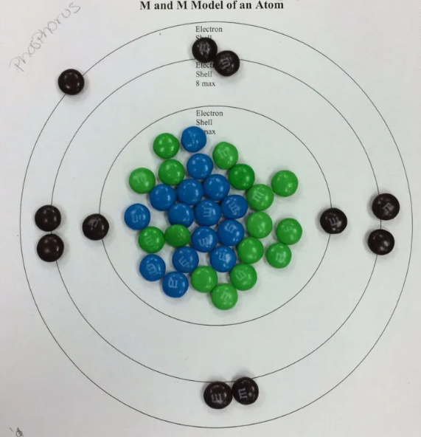
GRADES 2–3
M&M Bohr Model
MATERIALS + PREP
M&Ms (3 colors: protons, neutrons, electrons)
Paper plates or cardstock circles
Markers for drawing electron shells
Periodic table handouts or display on board
Small cups for distributing candy
Optional: Pre‑draw concentric circles on plates (optional for speed)
Choose a list of allowed elements (atomic number ≤ 15)
STEPS
1. Introduce atoms
  Explain protons, neutrons, electrons
  Atomic number = protons; mass number ≈ protons + neutrons
  Electrons fill shells: 2 in first, 8 in second, 8 in third
2. Let groups choose an element
  Students pick an element with atomic number ≤ 15
  Identify protons, neutrons, electrons using the periodic table
3. Draw the Bohr model
  Nucleus in the center
  Concentric circles for electron shells
4. Build the nucleus
  Use one color of M&Ms for protons
  Use another color for neutrons
5. Place electrons
  Use a third color for electrons
  Fill shells in order: first → second → third
15-20 MIN
$15-20
SMALL GROUPS
NAYGN STUDENT OUTREACH • NUCLEAR SCIENCE WEEK ACTIVITY GUIDE
02

