Slide 1

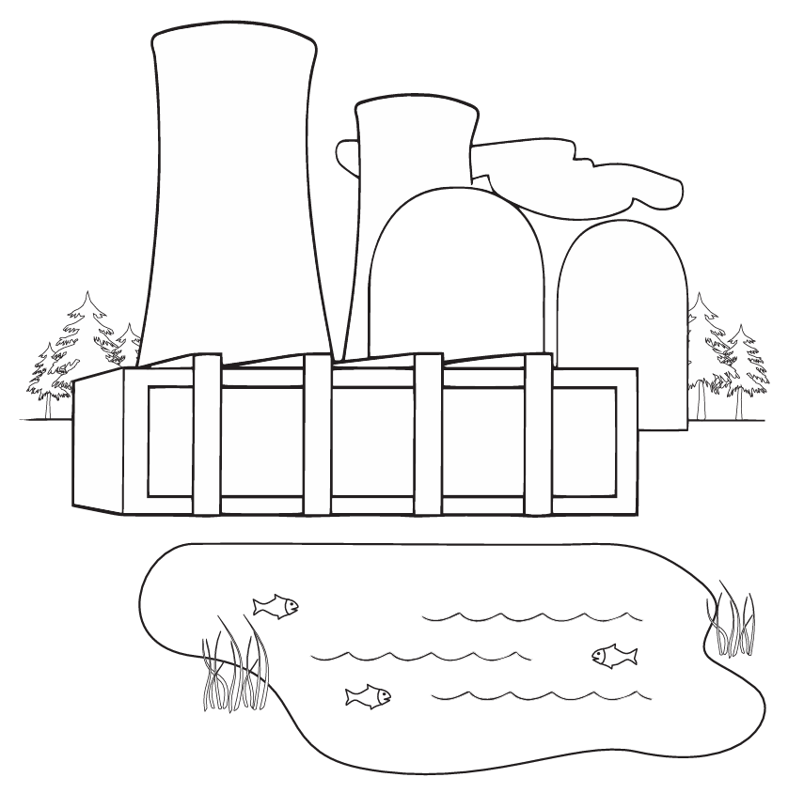
KINDERGARTEN–GRADE 1
Coloring Nuclear Energy
15-25 MIN
UNDER $5
MATERIALS + PREP
Printed copies of the Coloring Pages worksheet packet - Print plenty of copies of each coloring page so every student can have one or two
Crayons, colored pencils, or markers - Set out coloring supplies at each table.
Review the pages yourself so you know what each one shows.
ACTIVITY STEPS
Start with a short discussion about what things around the classroom use electricity.
Explain that nuclear power plants make electricity and help keep the air clean.
Hand out the coloring pages and briefly point out the main parts of the picture.
Have students circle any items in the picture that need electricity to work.
Give students time to color the page while you walk around and engage with them.
coloring pages.pdf
NAYGN STUDENT OUTREACH • NUCLEAR SCIENCE WEEK ACTIVITY GUIDE
01
Notes:
coloring pages.pdf

